Slide 1


Bus Reservation System using c++ programming
Name: Allu.Harini
Reg no: 192224032
Dept: AI & DS

Slide 2
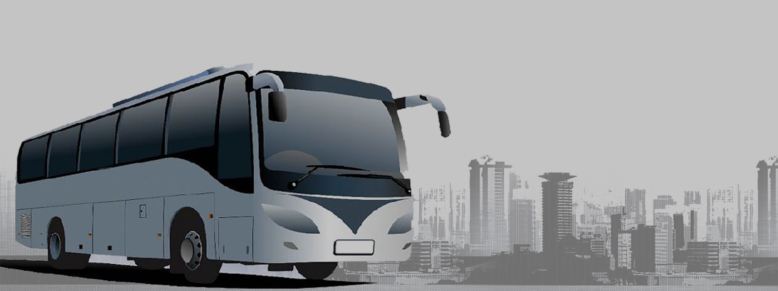
Tables of Contents
Introduction
Requirement Analysis
Scope
Design
Code
Output

Slide 3
Introduction to Bus Reservation System
Online Bus Ticket Reservation System is Windows based application that works within centralized network.
The software program "Online Bus Reservation System" provides bus transportation system, a facility to reserved seats, cancellation of seats and different types of enquiry which need an instant and quick reservasion.
It is built for to manage the ticket booking and tracking bus and travel made easy. It maintains all data's of users, bus details, reservation details, booking details, customer details.

Slide 4
Requirement Analysis
Requirement analysis is a software engineering task that bridges the gap between the system level software allocation and software design.
It enables the system engineer to specify software function and performance, indicate software interface with other system elements, and establish design constraints that the software must meet.

Slide 5
Scope
The scope of the online bus ticket reservation system is:
A person should be able to login to the system through the first page of the application
Query the buses for two weeks (Only two weeks advance reservation is available).
No reservation before two hours can be done.
Able to choose the seats which are available for a certain class.
Give details about the credit card.
Improved & optimized service.

Slide 6
Design
System design included designing of software and hardware.
The functionality of hardware and software is separated-out. After separation design of software modules is done.
The design process translates requirements into representation of the software that can be assessed for quality before generation of code begins

Slide 7
Modules Identified
Login module
Route Module
Bus Info Module
Exit Module

Slide 8
Code
void bookSeat(int seatNo) {
if (seatNo < 1 || seatNo > TOTAL_SEATS) {
cout << "Invalid seat number!\n";
return;
}
if (seats[seatNo - 1]) {
cout << "Seat already booked!\n";
} else {
seats[seatNo - 1] = true;
cout << "Seat " << seatNo << " booked successfully!\n";
}
}
void cancelSeat(int seatNo) {
if (seatNo < 1 || seatNo > TOTAL_SEATS) {
cout << "Invalid seat number!\n";
return;
}
if (!seats[seatNo - 1]) {
cout << "Seat not booked!\n";
} else {
seats[seatNo - 1] = false;
cout << "Seat " << seatNo << " canceled successfully!\n";
}
}
#include <iostream>
#include <iomanip>
using namespace std;
const int TOTAL_SEATS = 20;
bool seats[TOTAL_SEATS] = {false};
void displaySeats() {
cout << "Current seat status:\n";
cout << "====================\n";
cout << "Seat No.\tStatus\n";
cout << "---------------------\n";
for (int i = 0; i < TOTAL_SEATS; ++i) {
cout << setw(8) << i+1 << "\t\t" << (seats[i] ? "Booked" : "Available") << endl;
}
cout << "====================\n";
}

Slide 9
int main() {
int choice;
int seatNo;
do {
cout << "Bus Reservation System\n";
cout << "1. Display Seat Status\n";
cout << "2. Book a Seat\n";
cout << "3. Cancel Booking\n";
cout << "4. Exit\n";
cout << "Enter your choice: ";
cin >> choice;
switch(choice) {
case 1:
displaySeats();
break;
case 2:
cout << "Enter seat number to book: ";
cin >> seatNo;
bookSeat(seatNo);
break;
case 3:
cout << "Enter seat number to cancel booking: ";
cin >> seatNo;
cancelSeat(seatNo);
break;
case 4:
cout << "Exiting...\n";
break;
default:
cout << "Invalid choice!\n";
}
} while (choice != 4);
return 0;
}

Slide 10
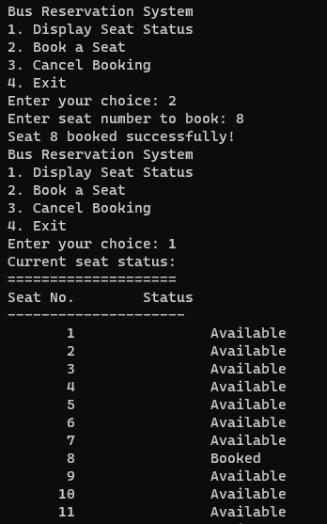
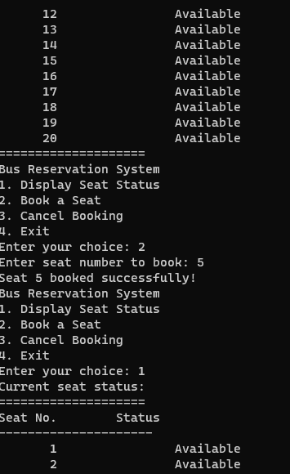
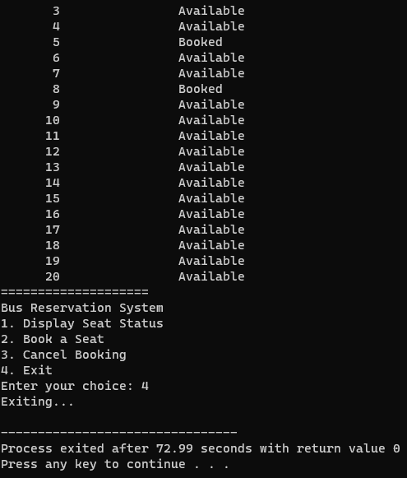
OUTPUT

Slide 11


